Slide 1


YOUTUBE SONG ANALYSIS
Power BI

Slide 2
3
OBJECTIVE
This internship project aims to conduct a comprehensive analysis of YouTube songs data using Power BI.
The dataset contains key attributes such as video ID, channel title, title, description, tags, published date, view count, like count, favorite count, comment, count, video duration, video definition, and caption details.
The goal is to utilize Power BI to create insightful visualizations and reports that provide a deeper understanding of YouTube songs' performance, popularity, and user engagement.
The analysis aims to uncover trends, preferences, and patterns in the data to aid content creators and stakeholders in optimizing their YouTube song content.

Slide 3
4
DATASET DESCRIPTION
1. video_id: Unique identifier for each YouTube video.
2. channelTitle: Title of the YouTube channel publishing the song.
3. title: Title of the YouTube song video.
4. description: Description provided for the YouTube song video.
5. tags: Tags associated with the YouTube song video.
6. publishedAt: Date and time when the YouTube song video was published.
7. viewCount: Number of views received by the YouTube song video.
8. likeCount: Number of likes received by the YouTube song video.
9. favoriteCount: Number of times the YouTube song video has been marked as a favorite.
10. commentCount: Number of comments posted on the YouTube song video.
11. duration: Duration of the YouTube song video.
12. definition: Video definition or quality (e.g., HD, SD).
13. caption: Availability of captions for the YouTube song video.

Slide 4
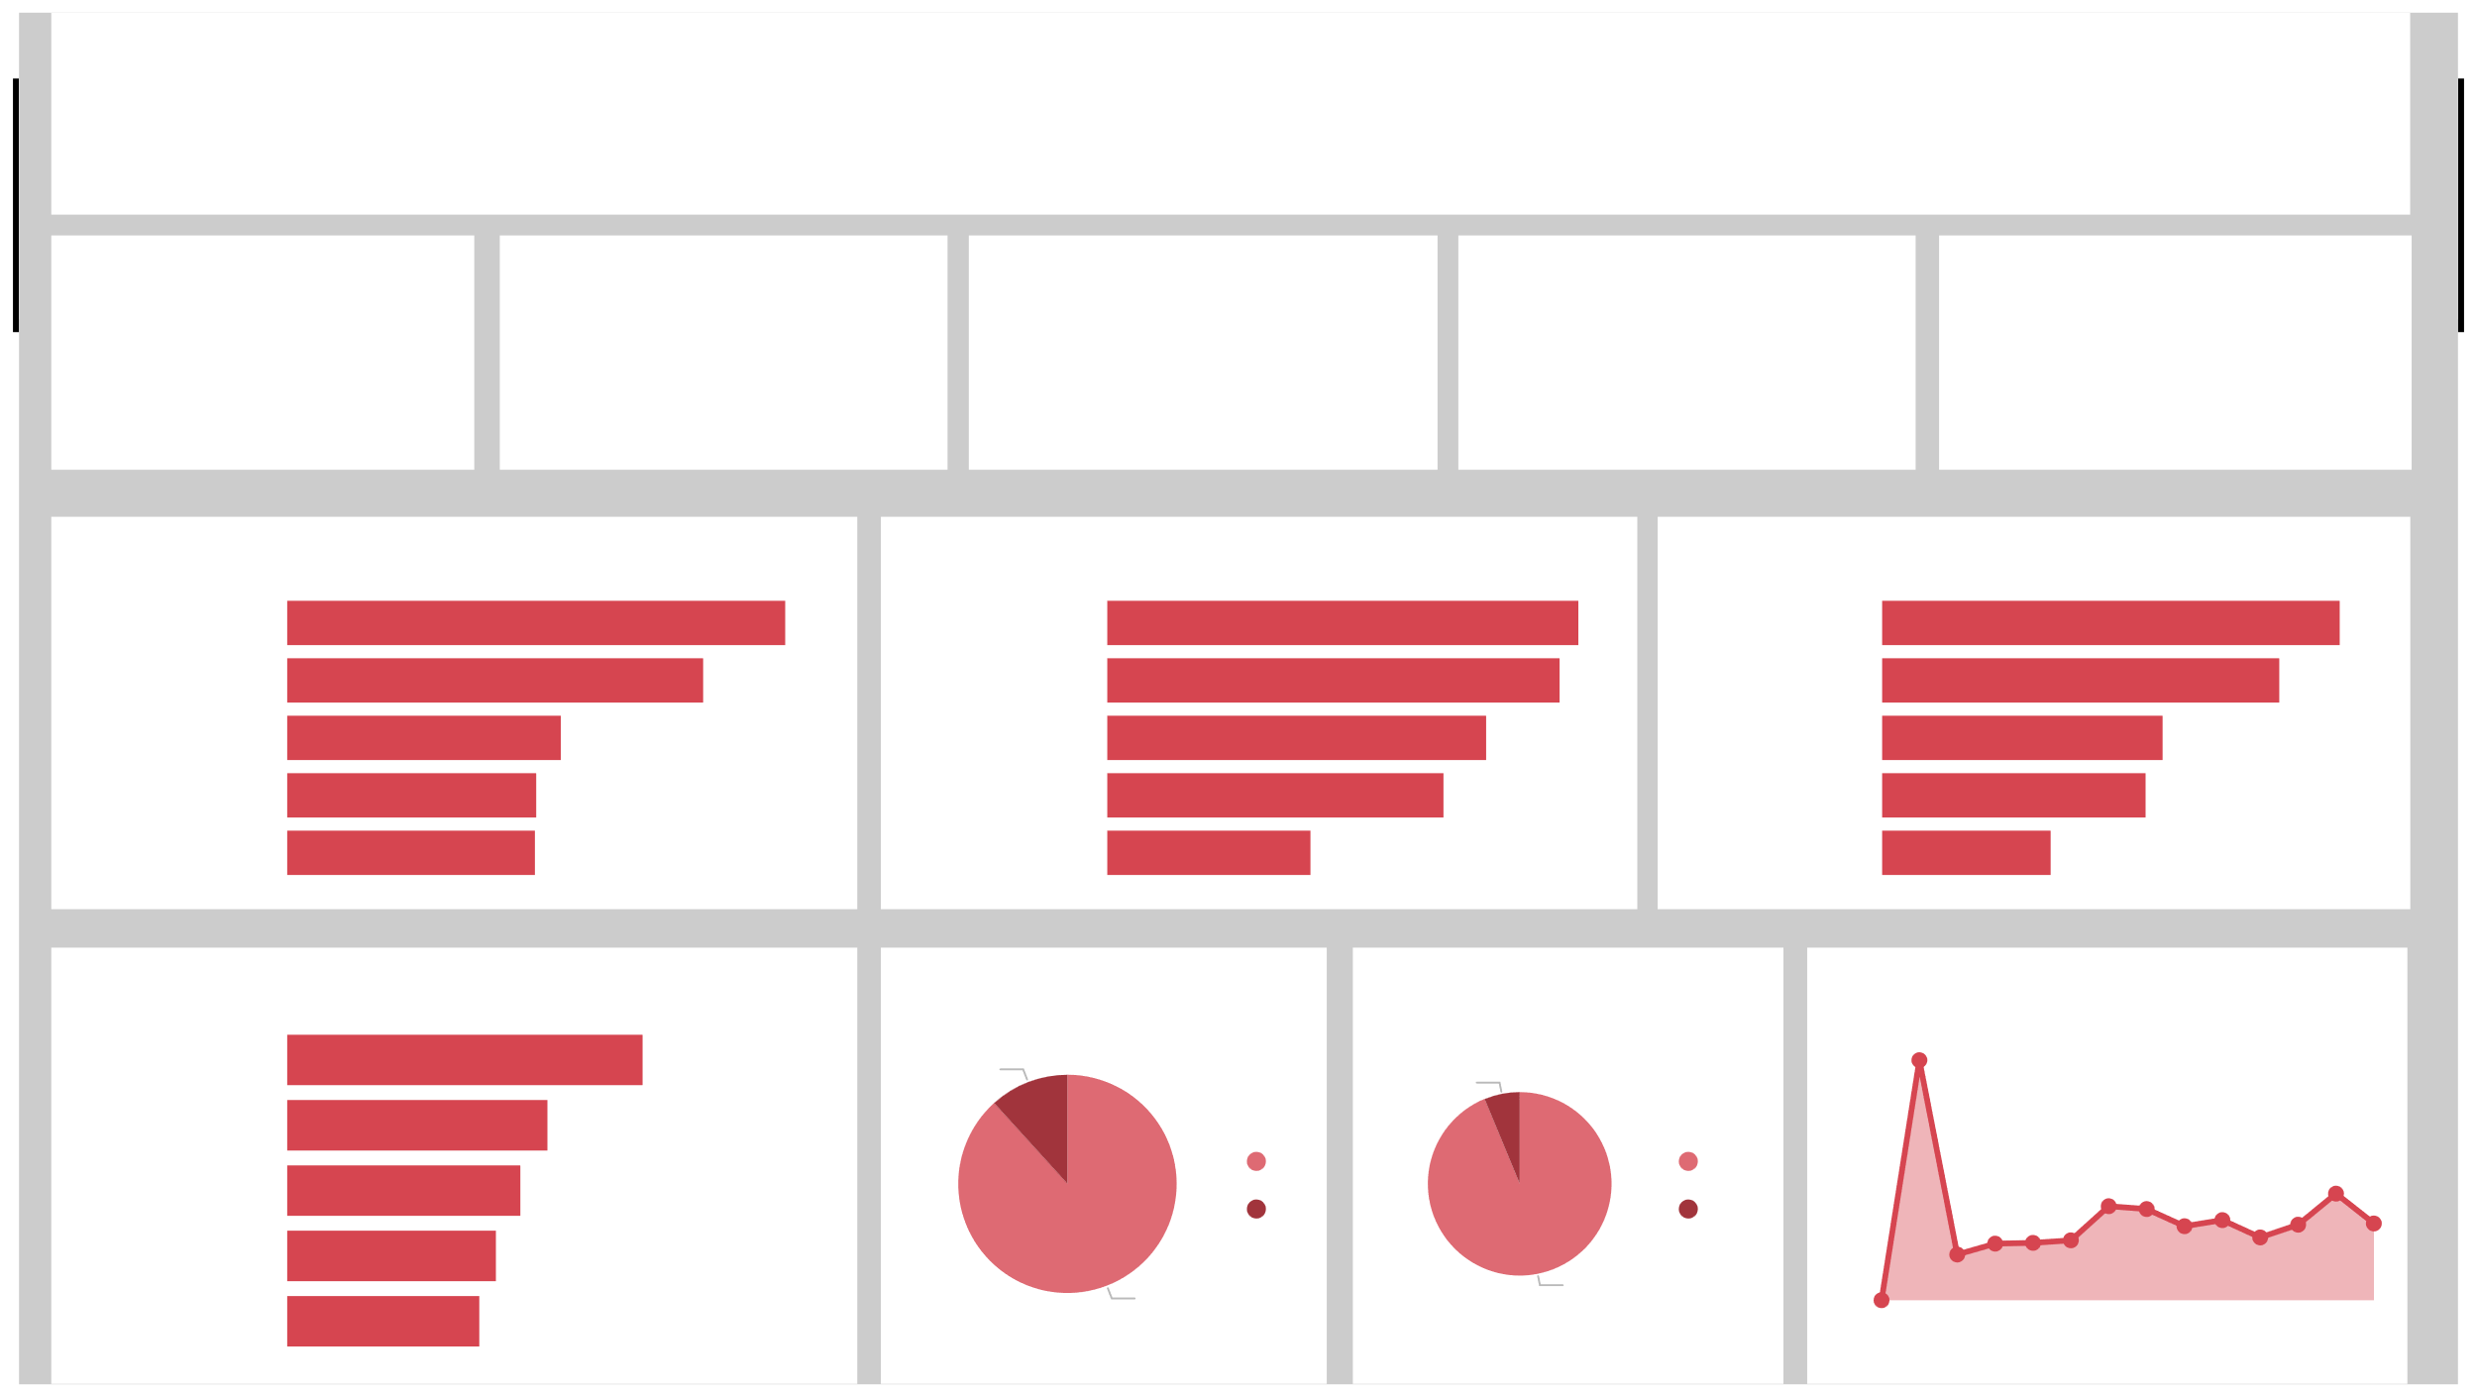


Power BI Desktop
SONG ANALYSIS
T SERIES
231bn
Sum of viewCount
2bn
Sum of likeCount
51M
Sum of commentCount
19.35K
Count of video_id
14.61K
Count of tags
Top 5 songs by likes
Top 5songs by comments
Top 5 songs by views
Vaaste Song: … Lut Gaye (Full… Full Song: KH… Official Video… Saiyaan Ji ► …
12.8M
Vaaste Song… Lut Gaye (Fu… Saiyaan Ji ►… Full Song: K… Official Vide…
0.35M
Vaaste Song… Lut Gaye (Fu… Full Song: K… Official Vide… Saiyaan Ji ►…
1.5bn
10.7M
0.34M
1.3bn
title
7.1M
title
0.28M
title
0.9bn
6.4M 6.4M
0.25M
0.9bn
0.15M
0.6bn
Song duration by duration
Duration vs Definition
View count vs caption
Total Videos by Year
Official Video…
4.1K
0.0047
11.75%
6.26%
4K
Lut Gaye (Full…
0.0034
Vaaste Song: …
0.0031
hd sd
False True
1.6K
1.8K
title
2K
Full Song: KH…
0.0028
1.3K
Saiyaan Ji ► …
0.0025
88.25%
93.74%
0K
0.0K
0.8K
2010
2015
2020
Year

Slide 5
13
Interpretation
Caption is not creating any impact on view counts
Videos with hd quality are getting most number of views.
Number of tags could create major impact on views.
Time of publishing videos are also creating a major impact on views.

Slide 6
THANK YOU

